Slide 1
R&D Text Corpora Filtering
and Data Mining:
Case Study on Digitalization
Data Science for the Public Good
27 June 2022
Notes:
Skylar

Slide 2


Introduction
Kristian Olsson
Major: Mathematics & Statistics
UVA Undergraduate: Class of 2024
Skylar Haskiell
Major: Computer Science
Minor: Biomedical Engineering
UVA Undergraduate: Class of 2024
Notes:
Skylar

Slide 3
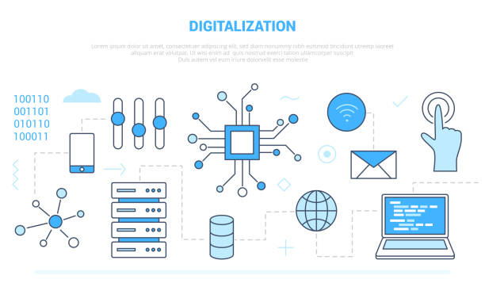
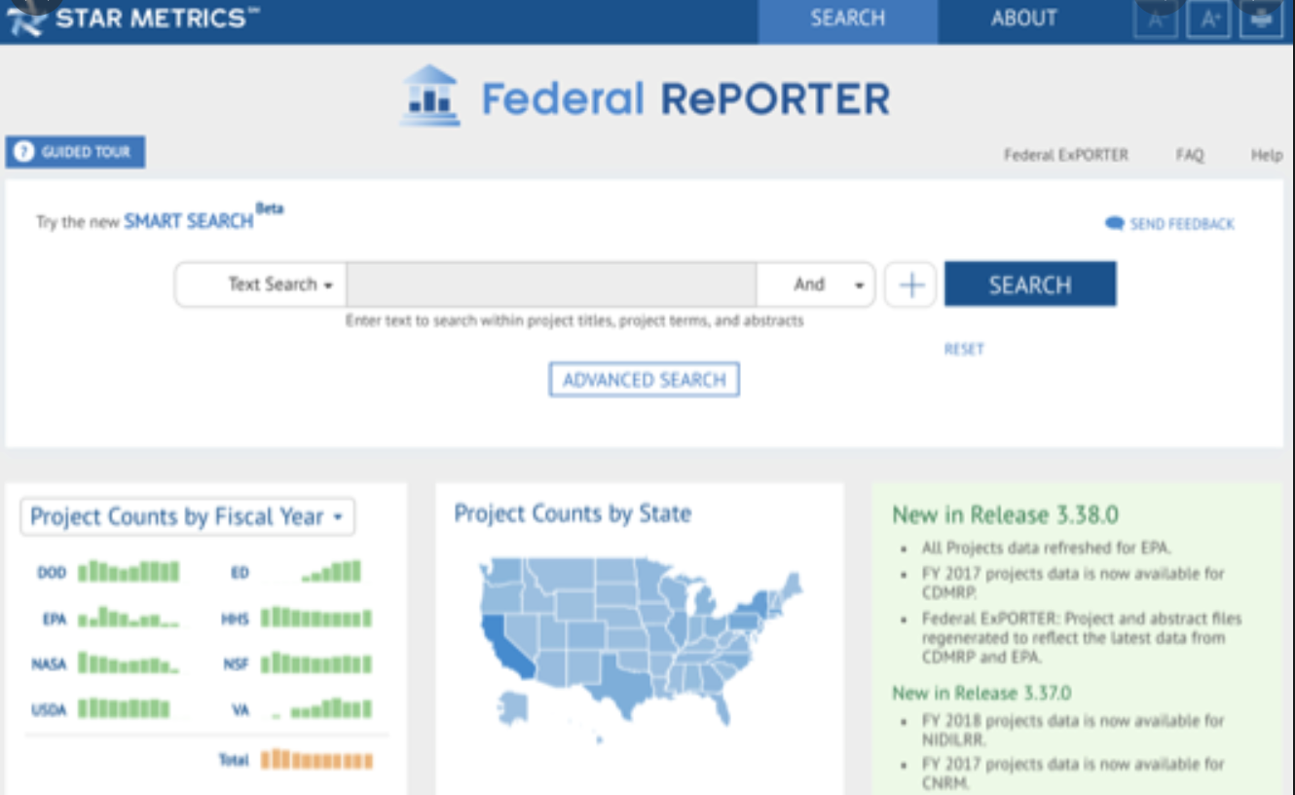
Project Introduction
Data Source: Grant abstracts contained in Federal RePORTER, 2008-2020
  We already have a cleaned dataset
  ~1.2 million abstracts
Sponsor: National Center for Science and Engineering Statistics
RQ: How can we characterize the R&D digitalization research area that the funding supported? What are trends in the digitalization research area?
RQ: What are the emerging topics in the area of digitalization within Federal RePORTER?
Notes:
Skylar
project is looking at data from Federal RePORTER, a data base for science and engineering grants, to look at digitalization as a research area
-cleaned set of abstracts, no duplications or empty , has 700,000 items
-need a way to parse through them to determine what is digitalization so we can track funding
-need to define digitalization in order to accomplish this

Slide 4
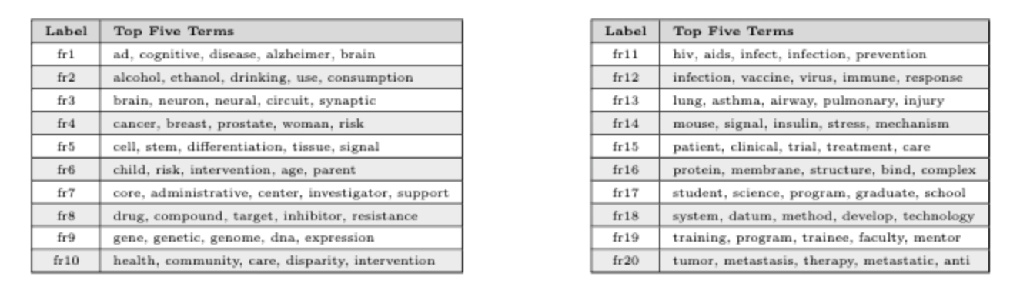
Prior Work – Topic Modeling
Data: Federal RePORTER grant abstracts
Methods:
Topic Modeling (latent Dirichlet allocation, non-negative matrix factorization)
Software: Python
Focus: Pandemics, Artificial Intelligence
Notes:
Skylar
-previous methods of searching through the data utilized latent Dirichlet allocation (generative statistical model that explains a set of observations through unobserved groups, and each group explains why some parts of the data are similar) and non-negative matrix factorization (roup of algorithms in multivariate analysis and linear algebra where a matrix V is factorized into (usually) two matrices W and H, with the property that all three matrices have no negative elements. This non-negativity makes the resulting matrices easier to inspect.)
- case studies on pandemics and artifical intelligence were explored

Slide 5
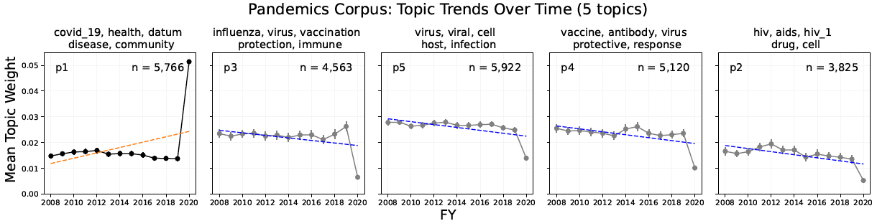
Prior Work - Pandemics
Data: Federal RePORTER grant abstracts
Methods:
Topic Modeling (latent Dirichlet allocation, non-negative matrix factorization)
Term-Matching
Latent Semantic Indexing
Notes:
Kristian
Prior to Skylar and I joining the team, they conducted a case study on the topic of pandemics using topic modeling – determine what topics there are within pandemic and how those have changed over time based on their mean topic weight, which is the number of abstracts on the topic divided by total number of abstracts
We use a linear model to see whether the number of reports has increased or decreased over time, which would correlate to funding increasing or decreasing respectively. So a negative slope would then identify areas that are receiving decreasing funding/attention such as HIV/AIDS on right
Three methods
•Topic Modeling – what Skylar just described
New Informational retrieval techniques
•Term matching: input a list of keywords related to topic and it identifies abstracts that contain those keywords
•Latent semantic indexing (LSI): dimensionality reduction technique that identifies abstracts related to the keywords. It is not necessary for the abstracts to contain the keywords – closeness of word
-> similar process for digitalization
Information Retrieval – filter corpus to identify theme-related projects
Term matching: identify abstracts that contain keywords
Latent semantic indexing (LSI): dimensionality reduction technique that identifies abstracts related to the keywords. It is not necessary for the abstracts to contain the keywords

Slide 6
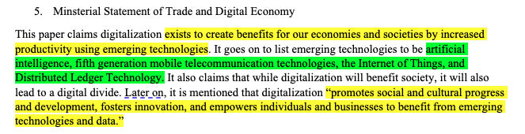
Digitalization Definitions – process
Completed initial reading of OECD sources
  Definitions of digitalization were highlighted in one color and key technologies were highlighted in a separate color
  Derived a single definition and list of technologies
  E.g.
Notes:
Kristian
· For our project, We are interested in understanding the topics within digitalization , and how the number of digitalization abstracts have changed over time
· Our first task was to determine what digitalization actually means
· to do this - Our sponsor, John Jankowski at NCSES, provided us with reports from the OECD (Organisation for Economic Co-operation and Development) and G-20 summits
· We read through those and defined digitalization and the technologies digitalization entails

Slide 7
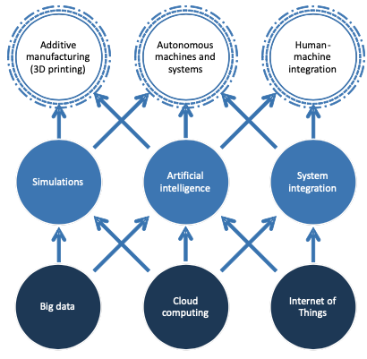
Digitalization Definitions – early findings
Digitalization is the innovative application and adoption of emerging technologies and data that promote social, economic, and cultural progress.
Key technologies that are driving digital transformation include the internet of things, artificial intelligence, cloud computing, autonomous machines, and big data among many others.
Figure 1: The confluence of key technologies enabling the industrial digital transformation
(OECD: The Next Product Revolution)
Notes:
Kristian
· Defined digitalization as Digitalization is the innovative application and adoption of emerging technologies and data that promote social, economic, and cultural progress.
· List of key technologies such as the internet of things, artificial intelligence, cloud computing, autonomous machines, and big data among many others. The figure to the right also shows the different technologies and how they are interrelated
· Definition and technologies – broad and all encompassing of any technology from the past 50 years where we changed analog forms of data digital, so we worked to make a more concise definition

Slide 8
Digitalization Definitions – process
All sources were from OECD and most from the G20 summit so many of the definitions were similar
  Look into a broader range of sources (National Academy of Science, Engineering, and Medicine, Google Scholar, UVA Virgo, Urban Institute, Brookings, etc.) to create a more precise definition
Notes:
Kristian
· We realized that Sources were all OECD and had similar definitions and key technolohies
· We wanted to make a more concise definition using a broader range of sources
· so we looked at other reports from the national academy of science, engineering, and medicine, as well as UVAs library and google scholar
-> new definition

Slide 9
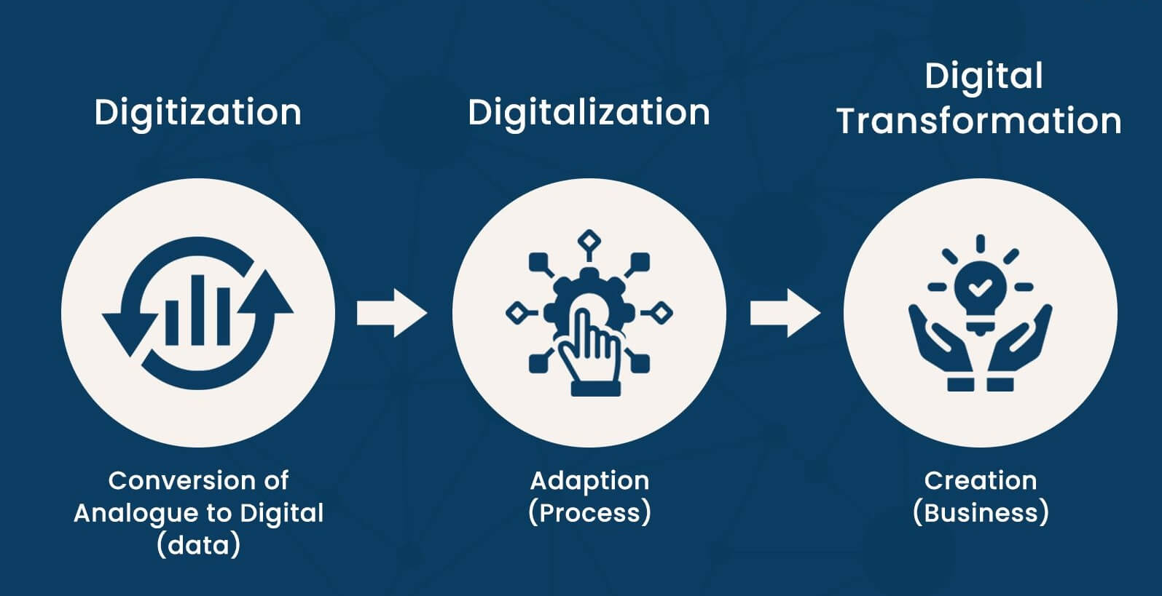
Digitalization Definitions – New Definition
Digitalization is the innovative adoption of emerging technologies to transform analog data into digital language, which, in turn promotes social, economic, and cultural progress.
Broad definition so we will focus on specific technologies/topics within digitalization
Figure 2: Differences in definition between Digitization, Digitalization, and Digital Transformation (Forbes)
Notes:
Kristian
· Our new definition is Digitalization is the innovative adoption of emerging technologies to transform analog data into digital language, which, in turn promotes social, economic, and cultural progress.
· This definition focuses on adoption of emerging technologies where you incorporate digital technologies to create value for organizations and communities
· This definition is still broad so we will likely do a few topics within digitalization such as big data or the internet of things

Slide 10
Information Retrieval Methods – early findings
Should we adopt a new abstract classification method?
  Improve performance
Current work: term matching and latent semantic indexing (LSI) to identify relevant abstracts
Other potential approaches:
  Upgrade dimensionality reduction technique from LSI to one using a neural network (for example, Word2Vec)
  Text classification based on traditional methods such as naïve Bayes or k-nearest neighbors (KNN)
    Involves training set creation, i.e. manual labeling of a subset of abstracts as relevant or not
Notes:
Kristian
· Next, continued literature review of information retrieval methods to improve performance and find most applicable method
· So far we have used term matching and latent semantic indexing to identify abstracts mentioned in pandemic case
· Looking into using approaches such using deep learning and neural networks to create a vector representation of how close words are to a keyword such as pandemics
· Other text classification methods include naïve bayes or k-nearest neighbors where you manually label a subset of the abstracts and determine if it relates to digitalization or not, which will train the computer to find similarities in other abstracts that relate to digitalization
-> Skylar will go into more depth
Neural Network for Information Retrieval : The idea is to compute the words embeddings (vector representation) of the query (searched terms) and document. Then compute the similarity between the query and the document. The key is to use deep learning to compute the vector representation.
Probabilistic Latent Semantic Analysis: The idea supposes a statistical model that explains the co-occurrence between data (words) with a latent structure. The model is fitted with data to compute the probability that a searched term is listed in a document.
NOTE: LDA is a generalization of PLSA

Slide 11
Naïve Bayes versus K-Nearest Neighbors
Both methodologies require a training set of abstracts labelled digitalization/not digitalization
Naïve Bayes
A common machine learning algorithm that measures the conditional probability of an abstract's topic given words/phrases in the text
Low variance
High Bias
K-Nearest Neighbor (KNN)
KNN algorithm is used to classify an object based on the closest distance between the object and its nearest neighbors in the training set
High Variance
Low Bias
Notes:
Skylar
Variance: variability of model prediction for a given data point or a value which tells us spread of our data. Model with high variance pays a lot of attention to training data and does not generalize on the data which it hasn’t seen before. As a result, such models perform very well on training data but has high error rates on test data.
Bias: difference between the average prediction of our model and the correct value which we are trying to predict. Model with high bias pays very little attention to the training data and oversimplifies the model. It always leads to high error on training and test data.

Slide 12
Next Steps
Literature review
Finalize digitalization definition and keywords
Assess different text classification methods
Specify topics in digitalization
Consider narrowing search past digitalization and into certain key technologies
Text classification
Label subset of abstracts (training set)
Trial methods in Python
Notes:
Skylar
Not entirely sure what method yet but leaning towards a trained data set due to expertise of the group and unfamiliarity with deep learning

Slide 13
Digitalization References
G20 Research Group. (2018). G20 Digital Economy Ministerial Declaration. http://www.g20.utoronto.ca/2021/210805-digital.html
International Telecommunication Union. (2018). G20 Digital Economy Task Force: Toolkit for Measuring the Digital Economy. https://www.itu.int/en/ITU-D/Statistics/Documents/g20-detf-toolkit_FINAL.pdf
Ministry of Foreign Affairs of Japan. (2018). G20 Ministerial Statement on Trade and Digital Economy. https://www.mofa.go.jp/files/000486596.pdf
Organisation for Economic Co-operation and Development. Digitalisation and Innovation. https://www.oecd.org/g20/topics/digitalisation-and-innovation/
Organisation for Economic Co‐operation and Development. (2016). G20 Innovation Report 2016. https://www.oecd.org/china/G20-innovation-report-2016.pdf
Organisation for Economic Co‐operation and Development. (2017). Key Issues for Digital Transformation in the G20. https://www.oecd.org/g20/key-issues-for-digital-transformation-in-the-g20.pdf (accessed on 16 July 2018).
Organisation for Economic Co‐operation and Development. (2017). The Next Production Revolution: A report for the G20. https://www.oecd.org/g20/key-issues-for-digital-transformation-in-the-g20.pdf.
Organisation for Economic Co-operation and Development. (2018). Bridging the Digital Gender Divide: Include, Upskill, Innovate. https://www.oecd.org/digital/bridging-the-digital-gender-divide.pdf
Organisation for Economic Co-operation and Development. (2019). Challenges to Consumer Policy in the Digital Age. https://www.oecd.org/sti/consumer/challenges-to-consumer-policy-in-the-digital-age.pdf
Organisation for Economic Co‐operation and Development. (2022). Recommendation of the Council on Artificial Intelligence. OECD/LEGAL/0449.

Slide 14
Digitalization References
Chao Su, C., Jun Liu, & Baohua Zhou. (2020). Two Levels of Digitalization and Internet Use Across Europe, China, and the U.S. International Journal of Communication (19328036), 14, 5838 - 5859.
International Joint Conference on Industrial Engineering and Operations Management. (2020). Digitalization: A Literature Review and Research Agenda. https://www.researchgate.net/publication/340067801_Digitalization_A_Literature_Review_and_Research_Agenda
Journal of Manufacturing Technology Management. (2009). The Need for New Product Development Capabilities from Digitalization, Sustainability, and Servitization Trends. https://www.proquest.com/docview/2469479098/fulltextPDF/1CD9DC0EA60744EAPQ/1?accountid=14678
National Academies of Sciences, Engineering, and Medicine. (2021). Advancing Commercialization of Digital Products from Federal Laboratories. Washington, DC: The National Academies Press. https://doi.org/10.17226/26006.
Organisation for Economic Co-operation and Development. (2019).Going Digital: Shaping Policies, Improving Lives. https://www.oecd.org/publications/going-digital-shaping-policies-improving-lives-9789264312012-en.htm
Strassner, E. H., & Nicholson, J. R.. (2020). Measuring the digital economy in the United States. Statistical Journal of the IAOS, 36(3), 647 - 655.
United Nations Conference on Trade and Development. (2019). Digital Economy Report 2019. https://unctad.org/webflyer/digital-economy-report-2019
World Patent Information. (2022). A review on digitalization trends in patent information databases and interrogation tools. https://www.sciencedirect.com/science/article/abs/pii/S017221902200014X

